Slide 1
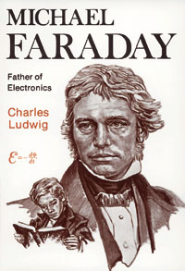
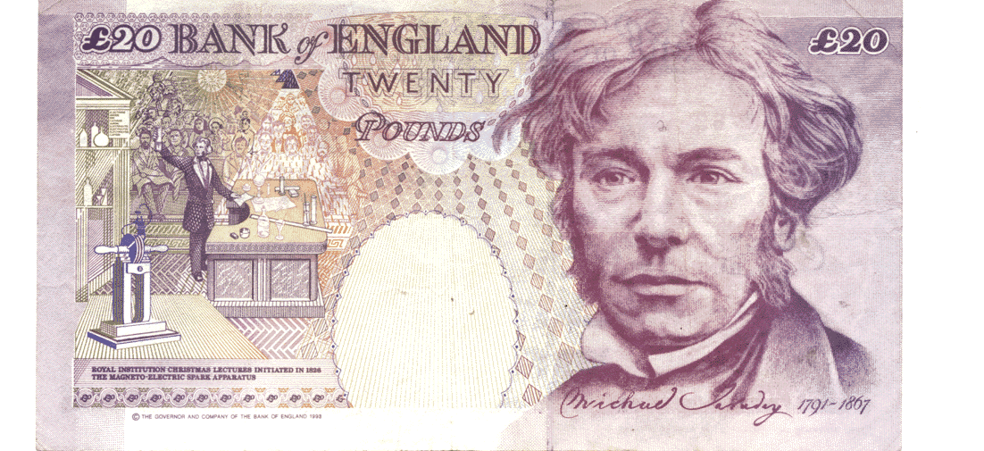

Faraday's Laws of Electrolysis

Slide 2
Faraday's laws of electrolysis:
Faraday’s 1st Law may be stated as follows:
"The amount of any substance deposited, evolved, or dissolved at an electrode is directly proportional to the amount of electrical charge passing through the circuit.”
The amount of electricity passing through the circuit in a given time is the number of moles of electrons passing through the circuit in that time, and the charge Q is related to the current I by
The charge on the electron is 1.602 x 10⁻¹⁹ C, and Avogadro's number is 6.023 x 10²³. It follows that one mole of electrons is 9.649 x 10⁴ C. This quantity is known as the Faraday or Faraday's constant (F).
Q = i t

Slide 3
Worked Example of Faraday’s 1st Law
What mass of metallic silver will be deposited from silver nitrate solution when a current of 0.53 A is passed through it for 95 min ?
The total charge, Q, passed through is the product of the
current (in amperes) and the time (in seconds). Thus,
Q = It = 0.53 x 95 x 60 = 3020 C
n(e⁻) = 3020/9.65x10⁴ = 3.13 x 10⁻² moles
Half-reaction of the reduction of silver is: Ag⁺ + e⁻  Ag. This tells us that one mole of electrons will reduce one mole (197 g) of silver ions.
Hence the mass of silver produced will be
m(Ag) = n x M = 197 x 3.13 x 10⁻² = 6.2 g.

Slide 4
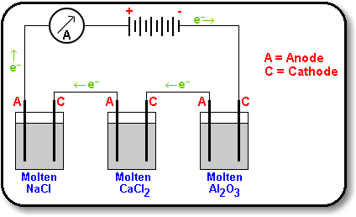
Faraday’s 2nd Law"The mass of different substances produced by the same quantity of electricity are directly proportional to the molar masses of the substances concerned, and inversely proportional to the number of electrons in the relevant half-reaction."
1 Faraday (1 mole of e-) will discharge 9 g Al (1/3 mole), 20 g Ca (1/2 mole) and 23 g Na (1 mole).
The relevant half reactions are:
Al³⁺ + 3e⁻  Al
Ca²⁺ +2e⁻  Ca
Na⁺ + e⁻  Na

Slide 5
http://www.ausetute.com.au/faradayl.html
AUS-e-TUTE link

Slide 6
End of Slide Show
To Return to Year 12 Tutorial List
Choose Back from Menu above

